Slide 1
The Australian Approach to Pension and Retirement Policy under Population Ageing: A Public Finance Perspective
John Piggott and Rafal Chomik
April 2024
Notes:
-

Slide 2
Presentation Structure
Broad approach to retirement policy analysis
Demographic and fiscal context
The Australian approach to retirement policy: Structure and Economic Impacts
Is this model mobile?
Concluding remarks

Slide 3
Broad approach to retirement policy analysis
Universal
Safety net for adequacy purposes
Targeted
Public provision
Pay As You Go
Private provision
Compulsory saving for income replacement
Funded
Public provision
Private provision
Employment related
Voluntary saving for
income replacement
Tax preferred
Other
Non tax preferred
Notes:
A common way to think about pension system design is to split it into three parts:
1st tier is about inc adequacy / safety net / poverty insurance
2nd tier is about inc smoothing (from working life to retirement) / or insurance against big drop in income
Key distinction among second tier:
pay-as-you-go (from current tax payers or workers to current pensioners)
funded (based on assets which will be sold to future workers)
Finally there are voluntary supplementary private savings, through employment or otherwise, encouraged via tax or not
Some examples will help clarify….

Slide 4
Broad approach to retirement policy analysis
1st pillar
Universal
1st pillar
Universal
Safety net for adequacy
Australian
Age Pension
Safety net for adequacy
Korean
Basic Old-Age
Pension
Targeted
Targeted
Public provision
Public provision
Korean National Pension Scheme
2nd pillar
Pay As You Go
Private provision
2nd pillar
Pay As You Go
Private provision
Mandatory income replacement
Mandatory income replacement
Funded
Public provision
Funded
Public provision
Superannuation Guarantee
Private provision
Private provision
3nd pillar
Employment related
Aust voluntary Superannuation + Special treatment of housing
3nd pillar
Employment related
Korean
Personal Pensions
Voluntary saving
Tax preferred
Voluntary saving
Tax preferred
Other
Other
Non tax preferred
Non tax preferred

Slide 5
2. Demographic and fiscal context
Source: UN 2019

Slide 6
2. Demographic and fiscal context
Source: OECD 2023

Slide 7
3. The Australian approach: Needs not rights
A simple example – unemployment benefits
For an ageing nation, a needs-based system is much more manageable in terms of fiscal outlays. Funds go where they have most social value
Universality is adopted where usage is universal (healthcare); otherwise, targeting (age pension)

Slide 8
3. The Australian approach: Complementarity of pillars
Public provision to cover needs (Age Pension)
Pre-funded private pillar with mandated saving (Superannuation guarantee)
Additional preferential saving for “life course assets”: supplementary pension saving and principal residence

Slide 9
3. The Australian approach:
Case for strong non-contributory pillar
Large informal sector
The “gig” economy
Sustainability in face of declining fertility and labour force
Flexibility of revenue source
Ageing, the mortality differential and equity

Slide 10
3. The Australian approach: The Age pension
Who is eligible? Age 67+, 10 year residency, subject to means tests
Unit of analysis? Income unit
Max benefit? 28% of average income (single); 40% of average income ( couple)
Which resources are tested, how? All income above $12k “disregard”’; all assets above a threshold, exempting principal residence
Taper Steep taper for both income and assets

Slide 11
3. The Australian approach: High coverage of Age Pension
Source: Authors’ analysis of Survey of Income and Housing

Slide 12
3. The Australian approach: Too high a coverage in some instances?
Source: Authors’ analysis of Survey of Income and Housing

Slide 13
3. The Australian approach: The design of the mean test
Income and asset tests in selected OECD countries (2012-2014)
Targeted pension income as % of AW
Source: Chomik et al. 2015
Notes:
Some examples:
Different countries define and combine resources in different ways.
Australia higher initial pension
More generous asset test.

Slide 14
3. The Australian approach: Understanding means testing trade off
Disposable income (y_{n})
(Private + pensions)
Benefit
A’
M
A
Private income (y_{g})
Y_{g*}
F(y_{g})

Slide 15
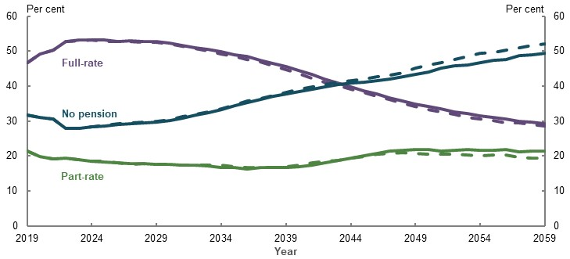
3. The Australian approach: Coverage to decline (by design)
Source: Treasury 2020

Slide 16
3. The Australian approach: Contributory pillar: Superannuation
Mandatory contributions paid into individual accounts: rising to 12% of wages
Low tax on both contributions and earnings; benefits are tax-free from age 60 (t-t-E)
Coverage at 90% of employees; 79% of working age population.
Benefits can be taken as an income stream or as a lump sum.

Slide 17
3. The Australian approach: Contributory pillar: Why mandate makes sense
To offset saving disincentives of a safety net (Hayek, 1960)
To offset dynamic preference inconsistency (e.g., Thaler 1981)

Slide 18
3. The Australian approach: Contributory pillar: Potential challenges
Preservation
Governance
Tax

Slide 19
3. The Australian approach: Economic efficiency and incentives
Labour supply: For those not anticipating the pension, only the tax rate on their labour income counts, not transfers at retirement (should means test income from exertion differently)
Saving: a very high proportion of aggregate private saving in developed countries is by the rich. A means tested pension does not impact the rich
Longevity insurance: Is available to the poor through the Age Pension, and also the rich as resources are depleted in late age and they become eligible for the Age Pension

Slide 20
3. The Australian approach: Equity
The poor: Get a full pension, which can be set to remove poverty (Poverty normally defined in relative terms.) They tend to have lower life expectancy (the mortality gradient)
The rich: Get no unfunded benefits. The implicit regressivity of a PAYG earnings related plan, induced by the mortality differential and earnings related benefits, goes away.

Slide 21
3. The Australian approach: Sustainability
Fiscal costs are kept low because transfers are flat rate, not earnings related, and the longer lived rich do not get a full pension, and in many cases, none at all.
Growth is stimulated through additional saving via mandated pre-funding (Kudrna 2023)
Notes:
Financial transfers hit at two points

Slide 22
3. The Australian approach: Private pension accumulation
Source: OECD (2022)

Slide 23
4. Is this model mobile? Relevance in ageing Asia
Constellation of characteristics in emerging Asia:
Rapid demographic transition
Fragile social protection structures
High informal labour ratio
Substantial internal migration
Non-contributory pensions should be investigated
Robust governance required for pre-funded pension policy: a separate issue
Notes:
Don’t call Korea emerging!! -Raf

Slide 24

4. Is this model mobile? Some modelling

Slide 25
4. Is this model mobile? Some modelling
Scenario 1) Baseline aging: use UN medium (fertility) population projections for Indonesia, with survival probabilities for 2020-2100 and pop growth (of newborn cohort), closely matching UN dependency ratio for 2020-2100.
Scenario 2) Increasing formal retirement age from 55 to 65 (over the first 25 years of transition) – directly impacting only formal high [Note: under this (in Indonesia already legislated) change, their productivity increases for ages 55-64 in the long run but they pay payroll tax for 10 more years and receive pensions from 65]
Scenario 3) Scenario 2 plus introducing social pension (in 2020-25) with value of 6.5% of per capita GDP – this flat rate is paid everyone at age 65 and over, except for high-skill formal group that gets PAYG pension. [Note: this social pension is non-contributory with the expenditure part of government fiscal budget]
Under each scenario above, there are two public budget constraints – Government fiscal budget and PAYG pension constraints balanced by consumption tax rate and payroll tax rate, respectively.

Slide 26
4. Is this model mobile? Some modelling results

Slide 27
4. Is this model mobile? Some modelling results

Slide 28
4. Is this model mobile? Some modelling results

Slide 29
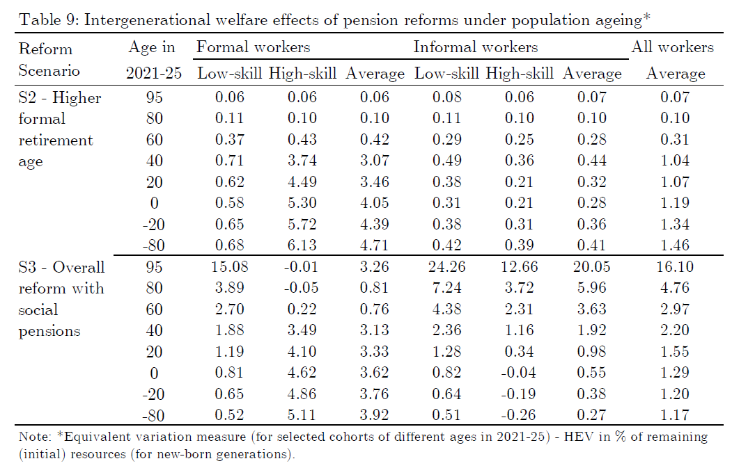
4. Is this model mobile? Some modelling results

Slide 30
4. Is this model mobile? Optimal tax and means testing
Include capital income in tax but nothing on differential rates
(Haig 1921 and Simons 1938)
Since retirement saving & retirement leisure are complements, means test may be an efficient tax on capital (Kumru and Piggott, 2010)
Don’t tax capital income to avoid distorting S→ I→ GDP→ W
(Judd 1985; Chamley 1986)
Including capital income limits tax expenditures, seen as lacking oversight
(Surrey 1973)
Age-specific taxes are less distorting (Erosa and Gervais 2002)
In absence of age-specific taxes, OLG shows should tax capital income
(Conesa et al. 2009)

Slide 31
4. Is this model mobile? Universal vs Means tested pensions
Uninsurable risks suggest that public pensions superior to self-provision (Hugett & Venture, 1999; Hugett & Para 2010)
Targeted pension is superior to universal pension
(Kumru & Piggott 2009; Tran and Woodland 2014; Kudrna, 2016)
Excluding more earnings from means test has a positive but small effect (Kudrna, 2015)
a steep taper is superior to a shallow taper (Kudrna, 2016; Dabbs, Kumru, and Piggott 2015)
Population ageing strengthens this superiority of means testing Kudrna et al (2022)
Self-provision superior to any public pension because of distortions (Auerbach & Kotlikoff 1987)
Notes:
As recently summarised in Chomik et al. 2015

Slide 32
4. Concluding remarks
Affluence-tested non-contributory pensions have been the centrepiece of Australian retirement income policy since 1909
They are shown to combine sustainability with adequacy, improving welfare and supporting efficient labour force participation
Income replacement in Australia depends on a pre-funded scheme, based on a 12% contribution, with 60 as the tax free access age
Non-contributory pensions can readily be implemented in countries throughout Asia. But mandatory pre-funded pension arrangements requires financial and public governance robust enough to deliver reliable contractual saving through several decades. Experience suggests that this is a high bar in emerging economies.

Slide 33

Email j.piggott@unsw.edu.au
Web www.cepar.edu.au
Twitter @cepar_research
Questions?
Sign up for our newsletter
Follow us on twitter

